Slide 1
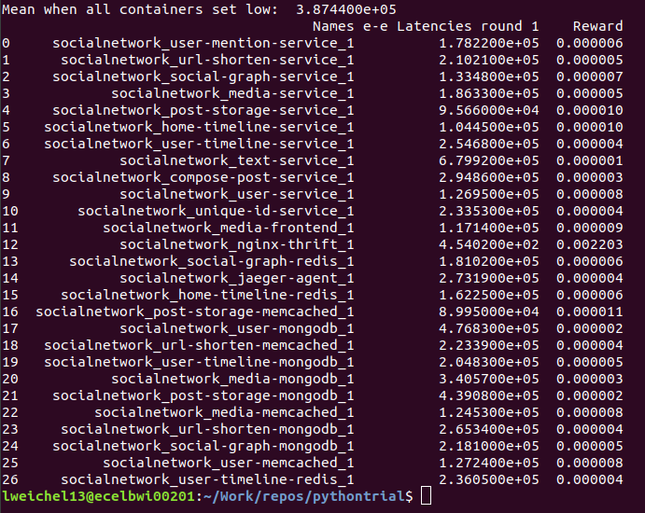

Team 71: Microservices Management for Distributed Computation
Bi-Weekly Update 1 Elizabeth Weichel Sponsor: Dr. Srinivas Shakkottai PhD: Ujwal Dinesha Master’s: Prathik Vijaykumar TA: TA Name
Notes:
Michelle

Slide 2
Project Summary
Autoscaling the CPU resources assigned to different containers
Thresholding algorithm updates CPU assignment to one container and scales based on e-e latency
Notes:
Kyle

Slide 3
Project/Subsystem Overview
Reading as input the e-e latency
Generating workload
Using .readlines() to read in e-e latency
Updating reward for container
Using os.popen to communicate with terminal
Performing as output CPU% update
Initialized an empty reward array that corresponds with each container
Updating the reward w/ 1/(e-e)
Docker command updates CPU% incrementally (so as to not over-allocate resources)
Notes:
Eric

Slide 4
Project/Subsystem Update
✅
Reading as input the e-e latency
Generating workload
Using .readlines() to read in e-e latency
✅
✅
Updating reward for container
✅
Using os.popen to communicate with terminal
Performing as output CPU% update
Initialized an empty reward array that corresponds with each container
Updating the reward w/ 1/(e-e)
Docker command updates CPU% incrementally (so as to not over-allocate resources)
Notes:
Eric

Slide 5
Major Project Changes for 404
All subsystems created
Thresholding Algorithm
Using subsystems in RL algorithm
404
Notes:
Eric

Slide 6
Project Timeline
September Sept/Oct Oct/Nov/Dec Dec Dec Jan Feb/Mar
Understanding Microservices & Docker Function | Obtaining latency metrics | Building thresholding algorithm (including CPU update) | Testing thresholding algorithm | Understanding RL background | Building RL algorithm | Testing & Verifying RL algorithm
Notes:
Eric

Slide 7
RL Algorithm Overview
Optimized CPU allocation vs. e-e latency
✅
Exploration
Exploitation
Initialize a reward function to 0 for each container
Loop through the containers, setting each one high and running a separate workload
Updating reward array w/ 1/(e-e) for each container
Learning from which containers have the highest reward, keep increasing the allocation
Can specify conditional for how long – whether it be iterations or target latency

Slide 8
Ways to Build from Here
Varying workload
Different types of workload
Testing different reward functions

Slide 9
Execution & Plan
Finish "exploitation" portion of Algorithm
Change types of workload
Test different reward functions
Use varying workload
Expand to different applications
Present at URS symposium and finish thesis
Notes:
Michelle

Slide 10
Questions?

